Slide 1
Do now
Draw the SHEEPT sheep.

Slide 2
PQE Analysis
7 HASS

Slide 3
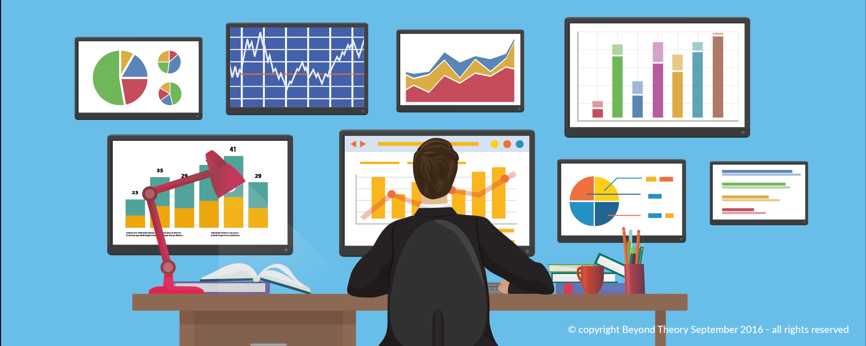
What is it?
PQE is a method geographers use to analyse data collected, such as: Table, Graph or Map.
Pattern
Quantify
Exception

Slide 4

PQE
Pattern | A general trend needs to be found. It is usually something that occurs numerous times.
Quantify | This means to add evidence (specific reasons) to prove that the pattern is correct.
Exception | An outlier, something that doesn’t fit in the general trend or varies.

Slide 5
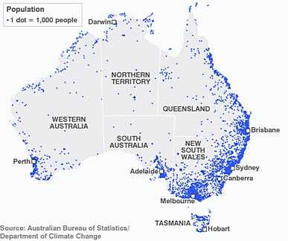

Slide 6

Pattern | Most of Australia’s population is on the east coast. There is very little people in the centre of Australia. Tasmania is heavily populated for its size. The bulk of the population is on the coasts of Australia.
Quantify | The majority of Australia’s population is on the east coast spreading through Victoria, New South Wales and Queensland. All capital cities and most populated areas are on the coast.
Explain | Cities that aren’t on the east coast that are still heavily populated are Perth and Adelaide. Perth is on the south-west coast of Australia and Adelaide is on the south.

Slide 7

Symbols
SHEEPT
PQE
Come up with some symbols for SHEEPT
Come up with some symbols for PQE

Slide 8

Earths Natural Spheres
Biosphere | Lithosphere
The realm of living things, including plants and animals. | The solid part of the earth's crust, consisting of rocks and soil.
Atmosphere | Hydrosphere
The layer of gases surrounding the earth. | All of earth's water bodies, including lakes, rivers, streams, oceans, groundwater and ice caps

Slide 9
Exit Ticket
List as many jobs in Geography as you can!

